Slide 1
JNCIS-ENT
Border Gateway Protocol (BGP)

Slide 2
BGP Neighbor States
3
BGP state machine

Slide 3
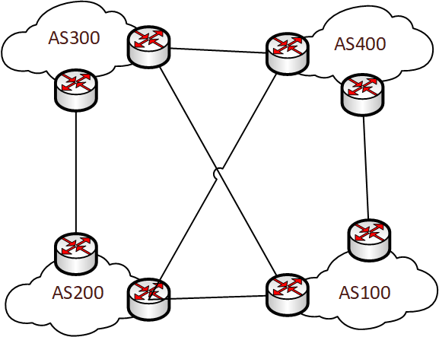
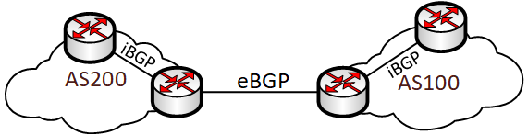
BGP Connectivity
BGP uses TCP as the transport protocol to establish connectivity
TCP port 179
The neighbor address must be manually defined
Dynamic neighbor discovery is not a feature of BGP
Since iBGP peers are typically configured between loopback interface addresses, an IGP is required to provide loopback connectivity

Slide 4
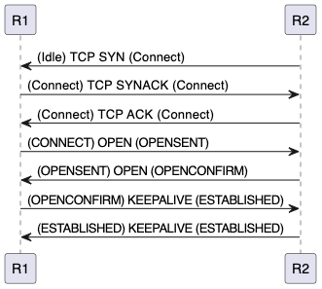
BGP Neighbor States
State | Description
Idle | Initial state. If lingering, BGP neighbor is configured but no route to neighbor address
Connect | BGP is waiting for a TCP session to be initiated from the remote peer
Active | TCP session is still attempting to be initiated with the neighbor and waiting to complete
OpenSent | TCP session has been established and a BGP OPEN message is sent to the peer. BGP waits for a responding OPEN message
OpenConfirm | Once OPEN messages have been exchanged, BGP waits for a KEEPALIVE or NOTIFICATION message
Established | Peering is fully established. UPDATE, NOTIFICATION and KEEPALIVE messages may be exchanged when established.

Slide 5
BGP Neighbor Establishment

Slide 6
BGP Neighbor Teardown
Established neighbors may return to Idle state under several circumstances
If a NOTIFICATION message is received
If the KEEPALIVE timer expires
If an error is detected in an OPEN message

